Slide 1
DARPA Meeting
Yongliang Sun
2025.10.8

Slide 2
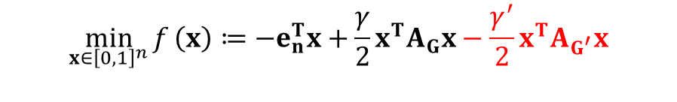
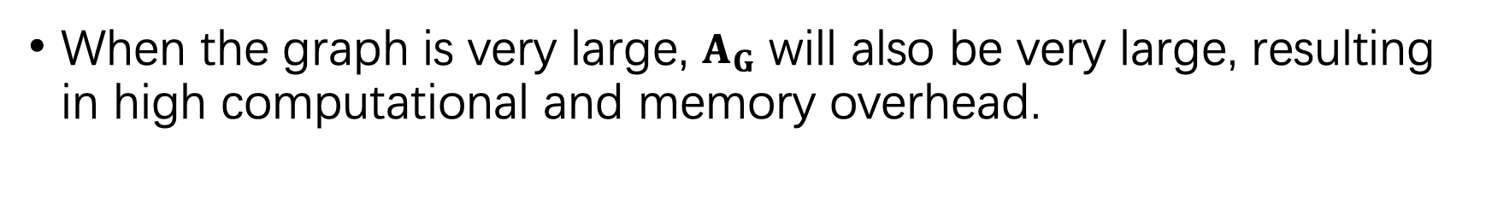
Differentiable Quadratic Optimization for the Maximum Independent Set Problem
The optimization-based reconstruction model proposed in this paper is as follows:
$$\min_{x∈{\left[0,1\right]}^{n}}{f}\left(x\right)≔−e_{n}^{T}x+\frac{γ}{2}x^{T}A_{G}x−\frac{γ^{′}}{2}x^{T}A_{G^{′}}x$$
The gradient vector can be expressed as:
$$g\left(x\right)≔∇_{x}f\left(x\right)=−e_{n}+\left(γA_{G}−γ^{′}A_{G^{′}}\right)x$$
When the graph is very large, $A_{G}$ will also be very large, resulting in high computational and memory overhead.

Slide 3
Subgraph sampling
The goal is to reduce memory and FLOPs.

Slide 4
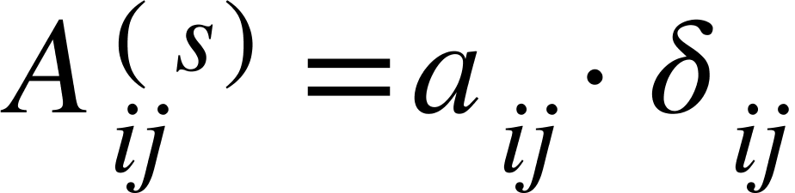
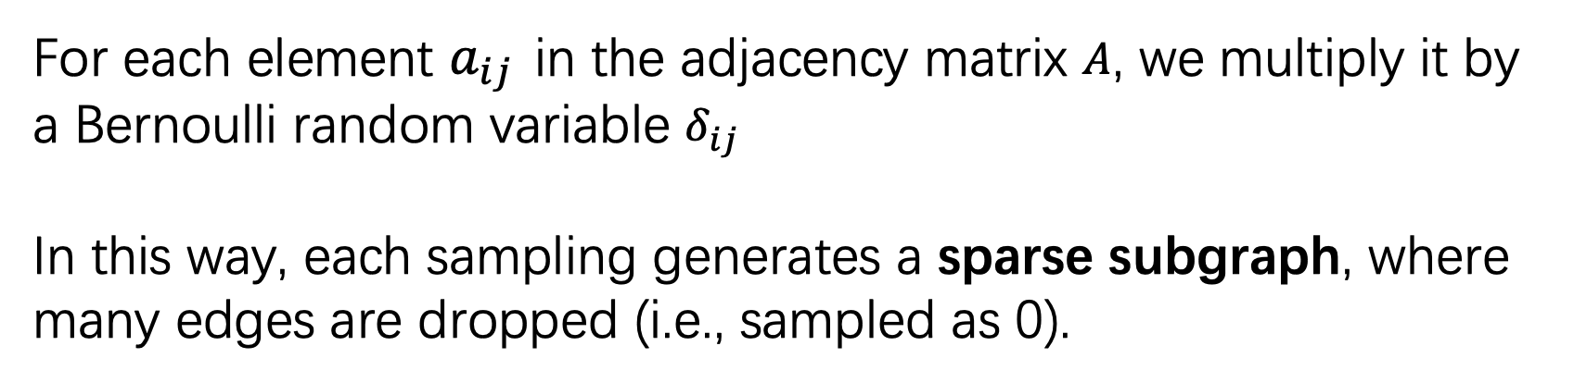
Step 1: Bernoulli Sampling
For each element $a_{ij}$ in the adjacency matrix $A$, we multiply it by a Bernoulli random variable $δ_{ij}$
In this way, each sampling generates a sparse subgraph, where many edges are dropped (i.e., sampled as 0).
Let $A=\left(a_{ij}\right)$ denote the original adjacency matrix.
$δ_{ij}$ ~ Bernoulli(p), and to ensure the sampled graph remains undirected, we enforce symmetry: $δ_{ij}=δ_{ji}$
After each sampling, the resulting (sparse) adjacency matrix is:

Slide 5
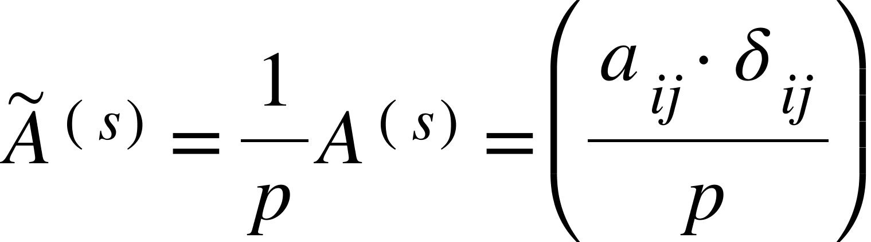
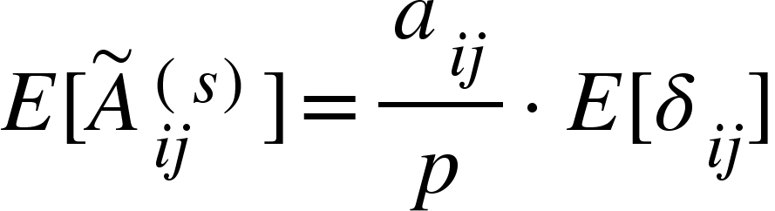
Step 2: Normalization:
To ensure that the sampled matrix is an unbiased estimator of the original matrix in expectation, normalization is required:

Slide 6
(u, v) pairs
The storage format of the ER graph has been changed to store (u, v) pairs instead of using an adjacency matrix.
For each edge (u, v), enforce u < v to avoid duplicates.
Compared to extracting subgraphs from an adjacency matrix, using (u, v) pairs is more efficient for subgraph sampling.

Slide 7
Experimental Setting
In our experiments, we use ER graphs, where the number of nodes is [200, 400, 600, 800].
The probability of having an edge between two nodes is set to 0.5.
For each node size, we generate 10 different graphs using 10 random seeds. On each graph, we run 50 trials, and then we take the best result from each graph and average them.

Slide 8
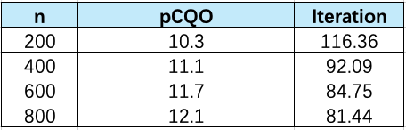
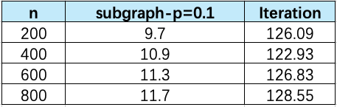
Using random subgraph sampling

Slide 9
Pre-storing Subgraphs
Since randomly sampling subgraphs in each iteration may still leave some edges untouched even after 150 iterations, so we attempted a different approach:
we pre-divided the ER graph into 10 subgraphs in advance, ensuring that every edge is covered.
Each subgraph contains non-overlapping edges.

Slide 10
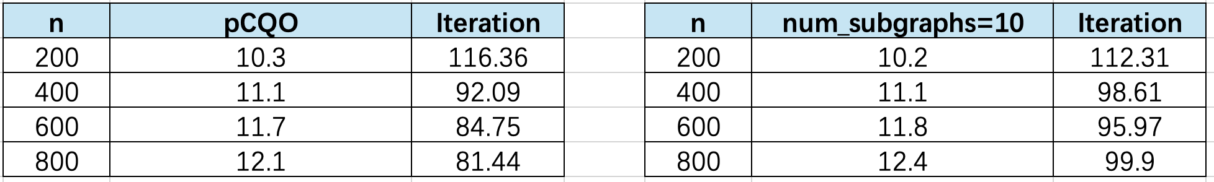
Experimental Result
The training strategy consists of 150 iterations, and in each iteration, a subgraph is selected from these 10 pre-stored subgraphs using the formula:
iteration % num_subgraphs.
Here, num_subgraphs refers to the number of subgraphs the original ER graph is divided into.

Slide 11
SVRG

Slide 12
SVGR
Although the gradient in SGD is unbiased, it has high variance. SVRG reduces the variance of the gradient through a correction mechanism.
The gradient update formula of SVRG is as follows:
∇f(w̃) refers to the full gradient computed on the entire graph at the beginning of each epoch;
∇fᵢₜ(wₜ) denotes the stochastic gradient computed on the i-th randomly sampled subgraph at iteration t;
∇fᵢₜ(w̃) is the gradient of the i-th subgraph evaluated at the reference point w̃, which is selected at the beginning of the epoch.

Slide 13
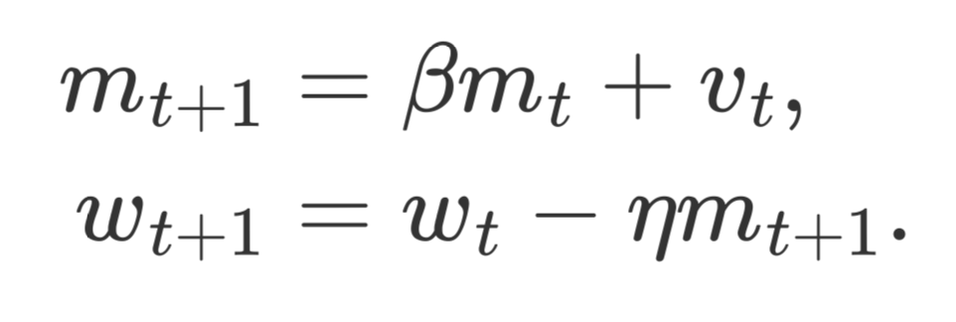
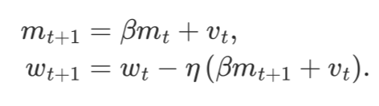
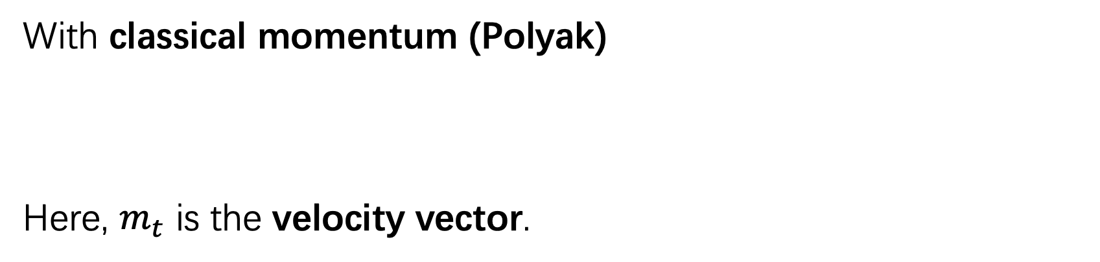
SVRG update
With classical momentum (Polyak)
Here, $m_{t}$ is the velocity vector.
With Nesterov momentum

Slide 14
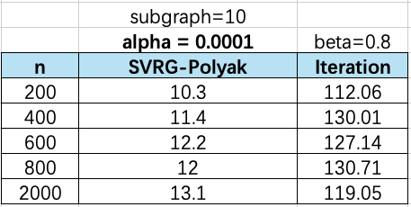
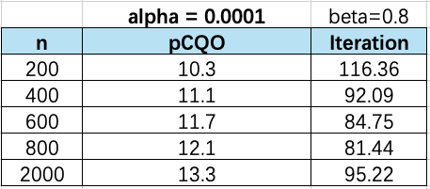
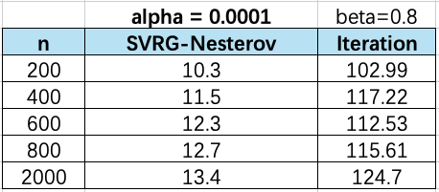
Experimental Result
The training strategy involves a total of 150 iterations, during which the edge list is randomly shuffled every 6 iterations.
After each shuffle, the following two types of gradients are recomputed: ∇f(w̃) and ∇fᵢₜ(w̃).

Slide 15
For next meeting
Try different subgraph sampling methods
GPU acceleration and memory optimization
Add runtime comparison

